Slide 1

A Browser-Based RISC-V Emulator
Adaptive and Secure Computing Systems (ASCS) Laboratory
Team Lead: Mihailo Isakov
Project Advisor: Prof. Michel A. Kinsy

Slide 2
BRISC-V Emulator
BRISC-V Emulator let’s you:
Run RISC-V assembly code in the browser
Run code until completion or until it hits a breakpoint
Step through it instruction-by-instruction
Debug hand-written assembly
View the state of memory and registers at each step
View how each instruction is constructed – registers, immediates, opcodes, etc.

Slide 3
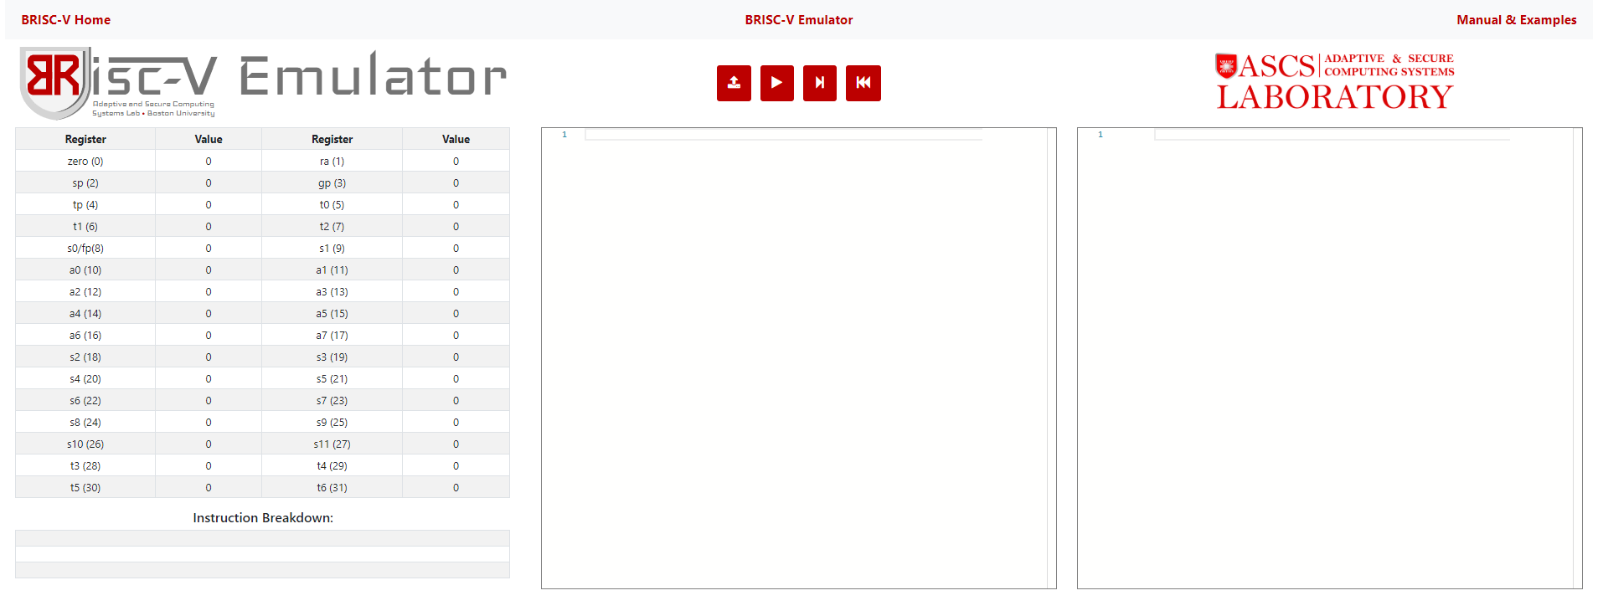
BRISC-V Emulator Website
ascslab.org/research/briscv/emulator/emulator.html
Load code
Restart emulator
Run code
Step through code

Slide 4
BRISC-V Emulator Website
Don’t have valid RISC-V assembly code to start with?
We have provided some!

Slide 5
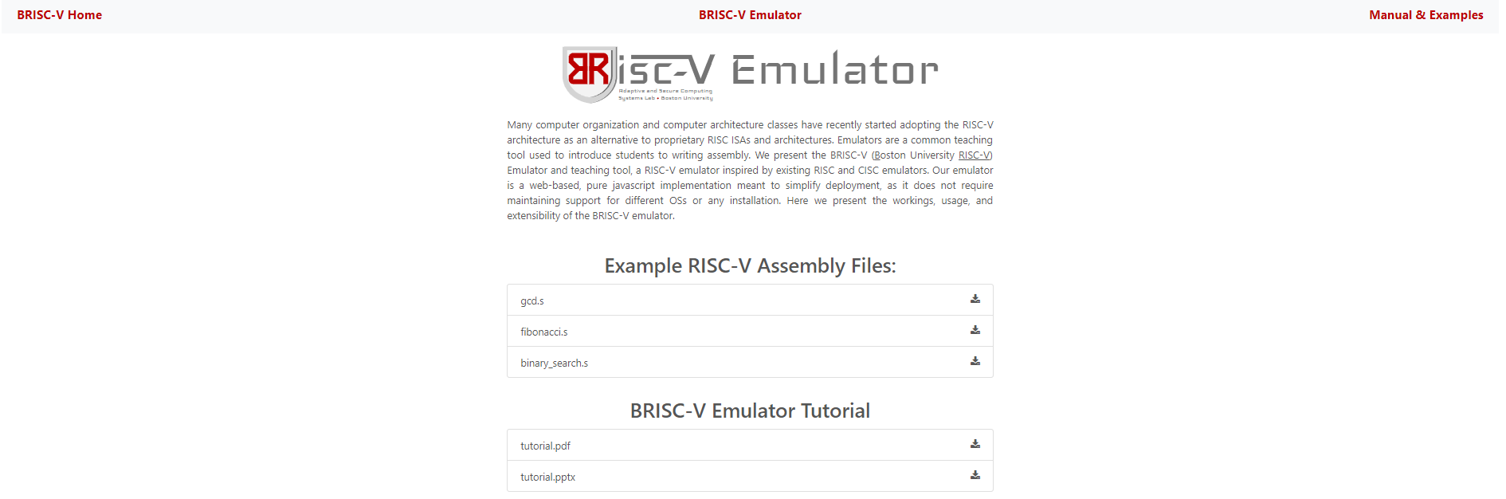
Manual & Examples
Simple code snippets!
RISC-V Instruction Set cheat sheet further down!
This tutorial!

Slide 6
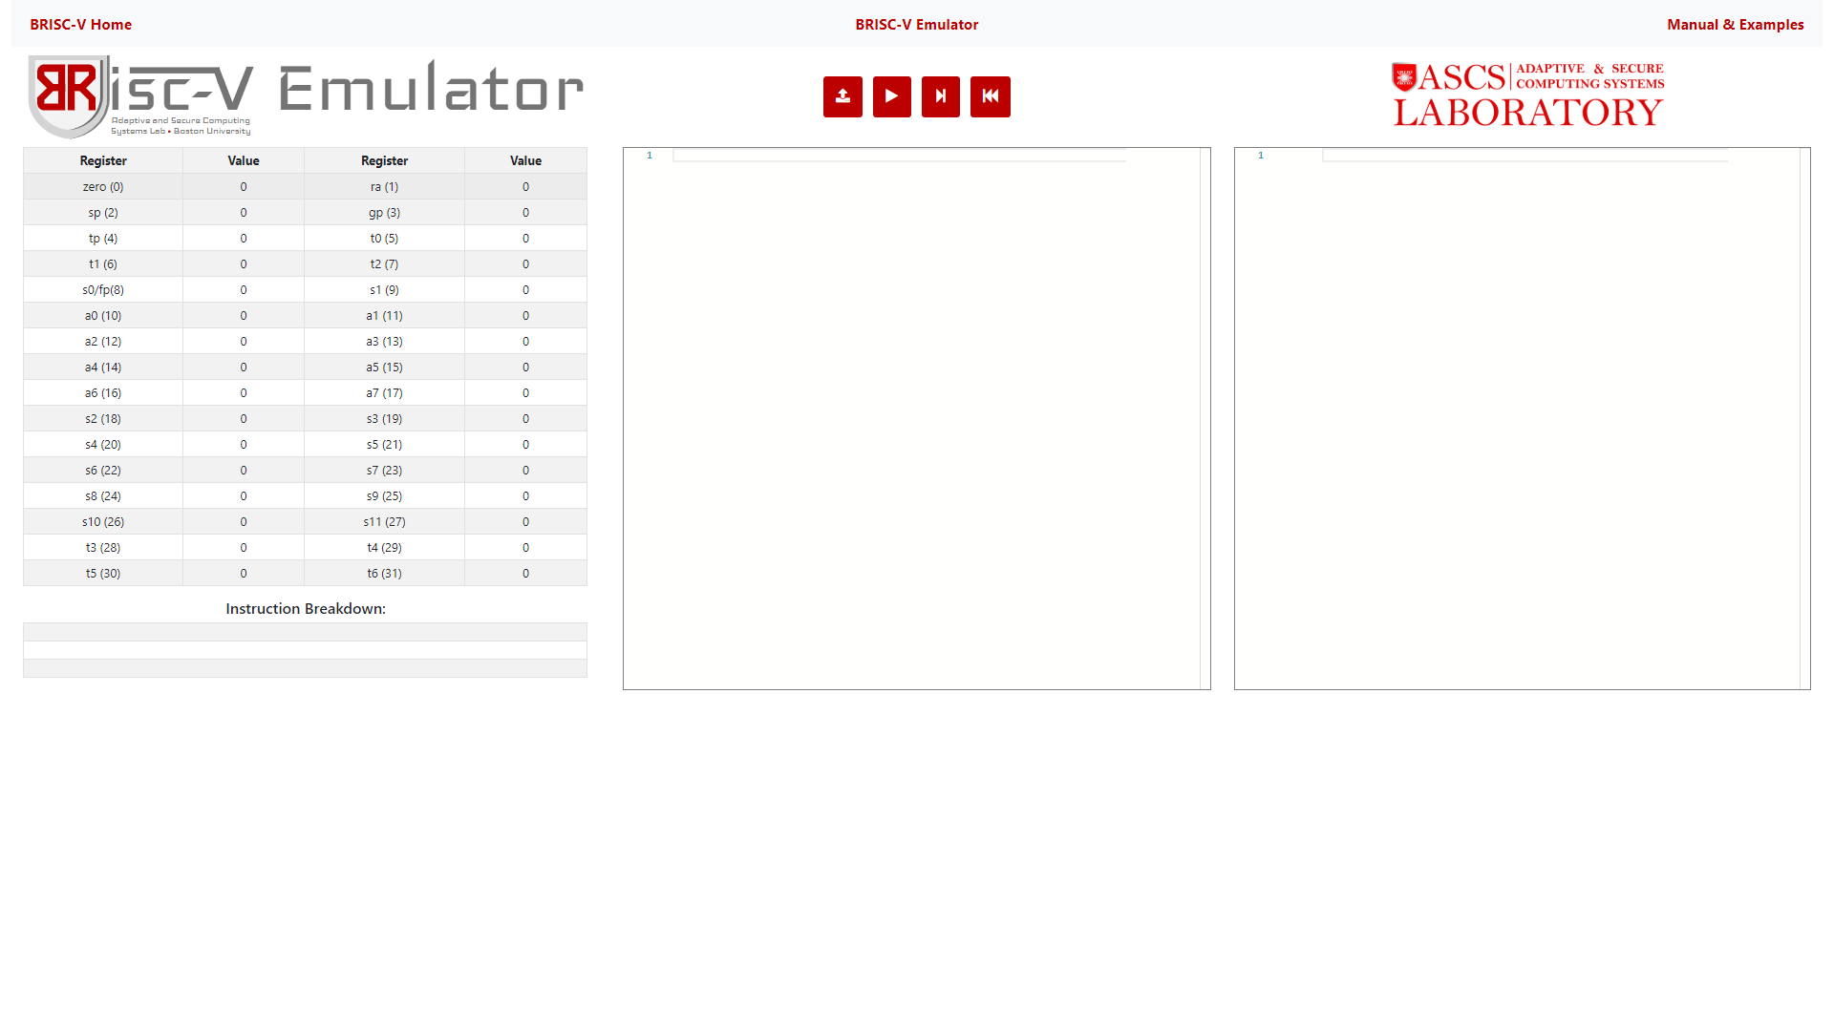
Using the Emulator
Load an assembly file (gcd.s for example)

Slide 7
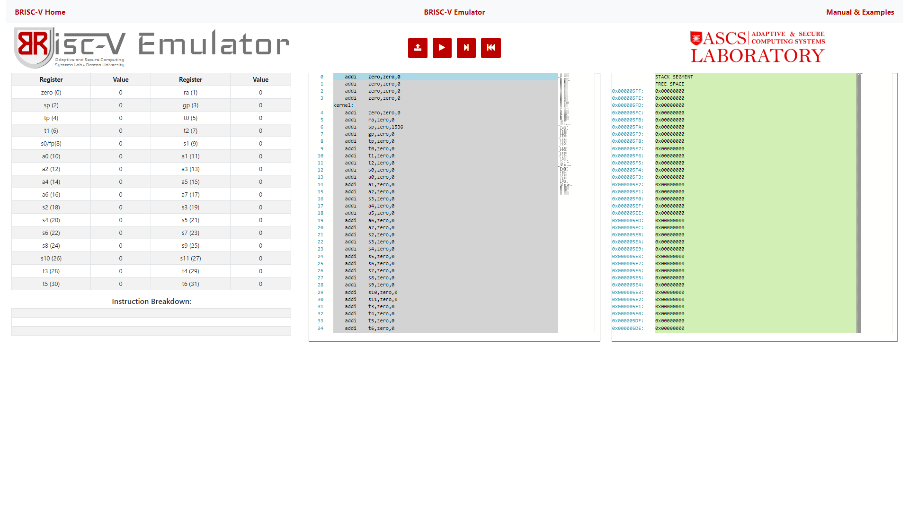
Using the Emulator

Slide 8
Using the Emulator
Register Pane
Code Pane
Memory Pane

Slide 9
Using the Emulator
Click the step button to run an instruction

Slide 10
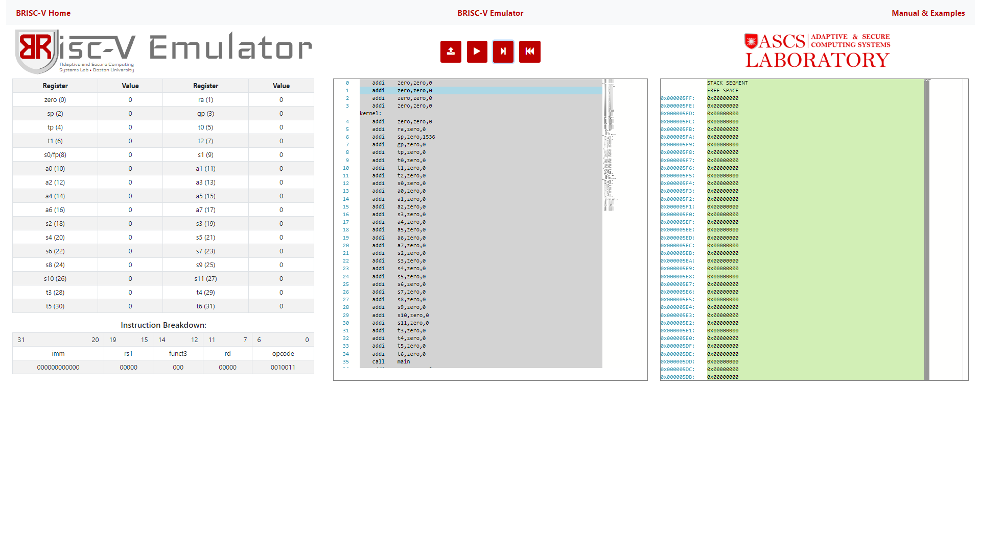
Using the Emulator
The blue line moved an instruction down!
The blue line shows the current instruction. It has not been executed yet.

Slide 11
Using the Emulator
Six clicks later…

Slide 12
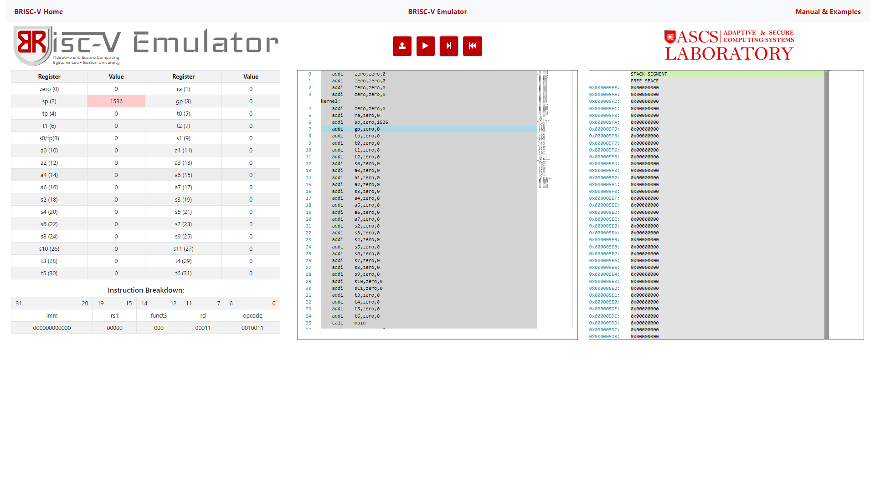
Using the Emulator
When an instruction changes a register, that register turns red
addi sp, zero, 1536
This instruction was just executed.

Slide 13
Using the Emulator
How the instruction is encoded can be viewed in the instruction breakdown pane.

Slide 14
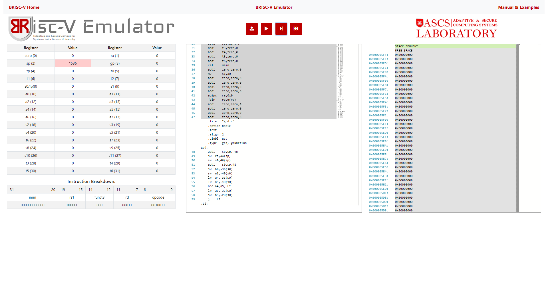
Kernel and User Instructions
Kernel Instructions
User Instructions
Some of the instructions have a grey, and some have a white background.
The grey instructions are kernel instructions – they setup the values of the registers, and put the emulator in an infinite loop once the user program has finished.

Slide 15
Kernel and User Instructions
The white instructions are provided by the user.
When you upload an assembly program to the emulator, it is wrapped in the kernel (grey instructions).

Slide 16
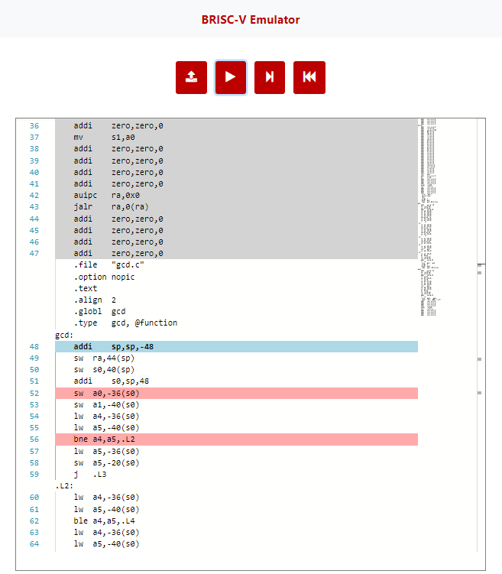
Breakpoints
The program stops when it hits a breakpoint.
Instruction pointer
These are breakpoints.
Right-clicking on an instruction opens a menu that allows placing a breakpoint.

Slide 17
Bugs & Features
Found a bug? Have an issue? Want a feature / RISC-V extension?
Send an email to briscv.feedback@gmail.com
Thanks!

